Slide 1



The Cause of Variability in FeLoBAL Quasar J1229+2621
Sofia Pasquini, Dr. Sarah Gallagher, KaylIe green, Dr. Karen LEighly, Joseph choi, Dr. Donald Terndrup
Notes:
Good morning everyone! My name is Sofia Pasquini and I have been working with Dr.Gallagher and Ph.D. candidate Kaylie Green here at Western University in Ontario, Canada in order to determine the cause of variability FeLoBAL quasar J122933.32 as a part of my research in my undergraduate degree which I have recently completed. Although I am a part of the Extragalactic research group here at Western led by Dr. Gallagher and Dr. Pauline Barmby, I have been working in conjunction with the research group at the University of Oklahoma led by Dr. Leighly, including Joseph Choi, from whom we have just heard.

Slide 2
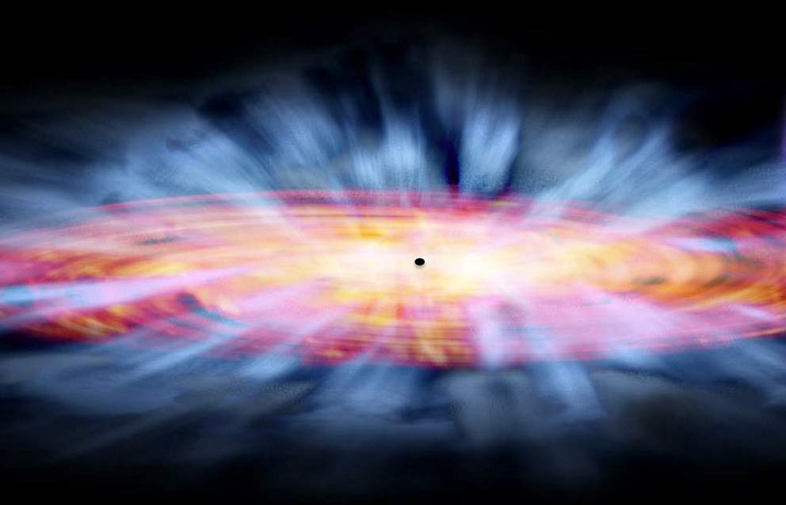
Project Motivations
Quasar winds/outflows influence the interstellar medium and star formation rates in host galaxies (Farrah et al. 2012).
Structure and kinematics of central quasar regions remain poorly understood.
NASA/CXC, & Tr’ehnl, N. (2016, March 21). [Artist’s impression of winds from supermassive black hole.]. Record-Breaking Ultraviolet Winds Discovered near Black Hole. https://news.psu.edu/story/398531/2016/03/21/research/record-breaking-ultraviolet-winds-discovered-near-black-hole
Fitting 3 epochs of spectroscopic data from a confirmed variable quasar.
Constrain physical parameters of the gaseous region close to black hole.
Relationship between black hole and evolution of host galaxy.
Notes:
On the right here I have an artists renditions of the winds that are launched from quasars. These winds or outflows are extremely powerful, and are believed to be one of the mechanisms by which quasars interact with and effect their host galaxies.
As you may know, quasars are extremely difficult to study, so in the context of relevant literature, the structures and kinematics of these outflows are severely understudied and generally poorly understood.
For this project, I have fit 2 epochs of spectroscopic observations in the optical/ultraviolet wavelength regimes, and one in the IR of FeLoBAL quasar J 122933.32 which is confirmed to be varying in the time domain. I have done this in order to constrain physical parameters which model the gases in the regions close to the central black hole for this quasar. In the hopes of coming to better understand this mysterious and exciting relationship between the evolution of the host galaxy and its central black hole.

Slide 3
BAL Quasar: sub-class of AGN; broad and significantly blue-shifted absorption features; 10-40% of the quasar population (Weymann et al. 1991, Knigge et al. 2008).
FeLoBAL Quasar: BALQ with both high- and low-ionization energy species + excited state Fe II or Fe III; 0.3% of quasar population (Trump et al. 2006)
NASA/CXC, & Tr’ehnl, N. (2016, March 21). [Artist’s impression of winds from supermassive black hole.]. Record-Breaking Ultraviolet Winds Discovered near Black Hole. https://news.psu.edu/story/398531/2016/03/21/research/record-breaking-ultraviolet-winds-discovered-near-black-hole
Notes:
Just as a formality, let us define a quasar as a luminous AGN powered by a central black hole. We define a Broad-Absorption Line Quasar as one which has characteristic broad absorption lines which have been significantly blue-shifted from their emission lines. This category of quasars is split further according to present spectral features. A BALQ which has been observed to have both high- and low-ionization energy species present in addition to excited state FeII or FeIII absorption lines are Iron-Lo-Ionization BroadLine Quasars, or FeLoBALS, for short. This category of BALQs is the most rare out of all of the other sub-categories, consisting of a population proportion of only about 0.3 ! FeLoBAL quasars, however, have the highest gas column densities of all other BALQ sub-types, and when coupled with the high velocities of their gas outflows, these objects have the ability to produce THE most powerful BALQ outflows. This is very important, and I will touch on this more in a few slides.
There is an artists rendition of a quasar in the top left, and on the right we see a cartoon cross-section of the structural components of a quasar. The central black hole is surrounded by a disk of swirling gas infalling towards the black hole, as well as what are believed to be systems of clouds known as the Broad Line Regions. I am particularly interested in the BLR.

Slide 4

Variability in SDSS J1229+2621
February 2013
April 2006
Notes:
As mentioned earlier, as the regions of interest for studying powerful quasar outflows cannot be spatially resolved using current technology, and as such, we rely on spectral variability studies as an important diagnostic tool for guiding our understanding of the origins of these powerful outflows. We observe spectroscopic variabililty in BALQs as in a change in strength of one or more spectral features as well as perhaps the appearance/disappearance of spectral features in time, though this is less likely to be observed.
Here I have included the two optical/UV spectra for FeLoBALQ J 122933.32 which I am studying, taken from the Sloan Digital Sky Survey. The first epoch was taken in April of 2006 and is given in red and the second epoch was taken nearly seven years later in February of 2013. We can see that this quasar is definitively exhibiting variability in several of its features as well as in the continuum emission. In general, observed changes such as these in spectral features are attributed to any combination of changes in the physical state of the gas as well as its position relative to the continuum emission source. By studying these changes, we are probing the physical state of the gas at distinct instances in time, and can begin to think about what kind of physical implications these changes imply in the context of the outflow we probe.

Slide 5

Broad Absorption Lines…Winds!
Broad Absorption Lines
Notes:
In purple here I have highlighted some prominent broad and deep absorption lines. Radiation pressure from continuum emission in the quasar drives these winds and results in these characteristic BAL signatures. Just to give you an idea, these winds are being launched from the central quasar regions at speeds on the order of tens of thousands of km per second! The heating and ejection of gas in this manner significantly reduces the materials available for star formation in the host galaxy. Further, these powerful mass outflows also contribute to the growth of the central SMBH as they remove angular momentum from the accretion disk, thereby improving accretion efficiency. It is in these ways therefore that quasar outflows play a significant role in the evolution of their host galaxy. So, by studying the BALS in BALQs, we directly probe these outflows. By probing the BALs of FeLoBAL quasars, we probe the most rare and powerful quasars in the Universe, which act as a vital test on existing or proposed quasar outflow models.

Slide 6


SimBAL: Analyzing Broad Absorption Lines
Initial Model- Our Best Estimate
Observed BALQ Spectrum
Synthetic Spectrum
MCMC
Algorithm
Best-Fitting Model
INPUT
OUTPUT
Original and Synthetic Spectrum Comparison
Photoionization Code
Physical Parameter Extraction
Figure adapted from Leighly et al. 2018, Figure 2

Slide 7
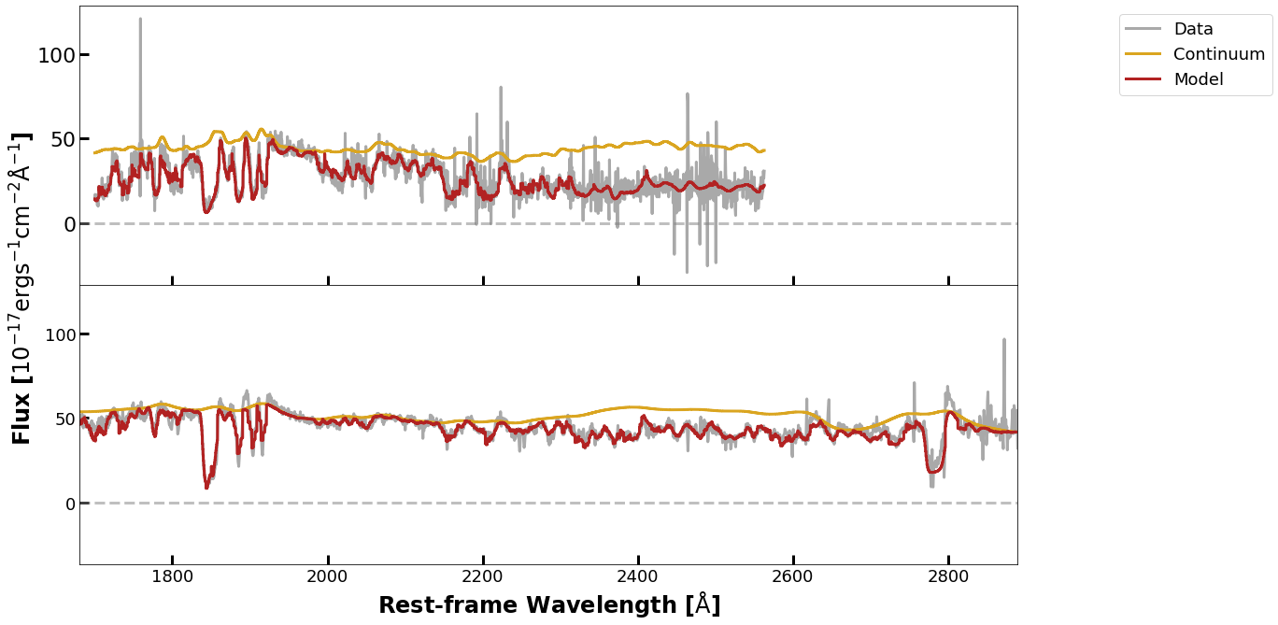
Best-Fitting Spectral Models
Epoch A – 04/22/2006
Epoch B – 02/15/2013
Notes:
Now I would like to present some of the results from my work: over the last year or so, I was able to successfully use SimBAL in order to model both spectra for two distinct epochs for the variable quasar I am studying. Here I have included both of these final best-fitting spectra; we have the flux from the quasar plotted as a function of wavelength in the rest-frame of the quasar in both cases. The actual spectra are plotted in grey, the continua are given in yellow, and the total output SimBAL model is given in red. The blue region highlights the associated 3sigma uncertainty regions.
Just to briefly touch on the construction of the models, in the case of both epochs, the best-fitting models were the ones in which all model parameters were held constant as functions of outflow velocity except for the column density and partial covering parameters. In both models, the main outflow opacity profile is modelled using a tophat accordian function, with 5 independent velocity bins per feature. We can see that these models do a pretty good job at capturing the shapes of the continuum and absorption/emission features in each case.
Working with SimBAL to find the best-fitting models for these epochs took up the majority of my time spent on this project, which was expected. This was because I had experimented with many different initial models or SimBAL inputs to see which one would end up being the most appropriate. I did this by examining the quality of fit of the output SimBAL models for each given initial model and making the appropriate changes to the initial model until I finally settled on these spectra here. The physical model which most appropriately models the light from this quasar is one in which the light from the continuum source is being absorbed by the outflow gas before reaching us, but the emission components are not. Why or how exactly this is happening is yet to be verified. Once I was able to settle on these models for both epochs, I was able to then access the information on the physical conditions of the gas at each of these points in time which are embedded in these models.

Slide 8
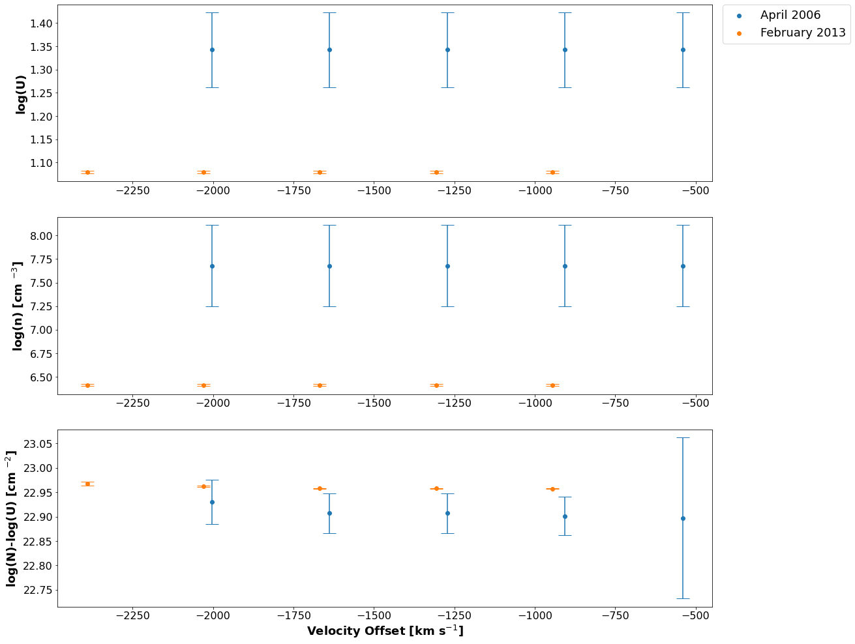
Ionization Parameter
-45.45% change!
Density
-94.58% change!
Column Density
12.75% change!
-but scaled with ionization param…
Notes:
Using the best-fitting models for each epoch, I was able to directly extract the associated best-fitting values of each of the model parameters, some of which I have plotted here to illustrate how they change between the two epochs. I was primarily concerned with the ionization parameter, density, column density, and covering fraction. The values of the parameters from the first epoch are given in blue, and the values of the parameters for the second epoch are given in orange. Each parameter is given as a function of velocity, which is the x-axis in each of these plots. The 95% confidence intervals for each of these parameters are also given by the error bars on each of the points in this figure.
Starting with the ionization parameter in the top panel, we see that there is a pretty significant jump down from the ionization parameter in the first epoch to the that of the second epoch, and overall these values stay the same for the velocities we are looking at. Already we are seeing changes in the physical parameters which are consistent with the changes observed visually in each of the spectra!
Next, we see a similar change in the density of the outflow across epochs in the second panel from the top. The density of the outflow in the first epoch is much higher than that in the second, though both are roughly constant as functions of velocity. The intervening matter along our line of sight in the third panel, however, does not seem to be changing significantly in time or in velocity at all.
Finally, in the bottom panel we are taking a look at the extracted covering fraction index values, and can see that there might be a slight variation in the covering fraction as a function of velocity, but not so much as a function of time.

Slide 9
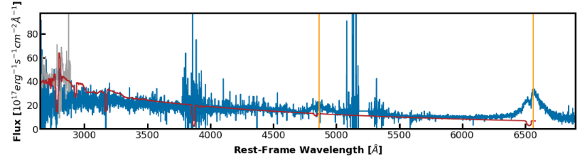
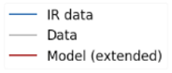

SimBAL Prediction of Balmer Absorption
H$β$
H⍺
Notes:
So here we have the spectrum we obtained from the Apache Point Observatory in blue, overplotted against the data from one of the optical spectra in grey and its corresponding SimBAL model extended into a longer wavelength range given in red. Of course we can see right away that the extended SimBAL model does not fit their spectrum very well or at all for that matter in this wavelength regime, and that is to be expected. After obtaining the IR spectrum from APO, we immediately noticed the absorption in the Halpha line as well as maybe a hint at what might be absorption in Hbeta as well. I have illustrated the wavelengths at which these emission lines are expected to be here in orange. We thought it might be an interesting experiment to extend the SimBAL model to these qavelengths and were happy to see that it was indeed able to predict this rare absorption. This absorption has only been observed in a handful of BAL quasars to date. So it is something very exciting to be able to observe, and even more interesting is the fact that the models from SimBAL were able to correctly predict this absorption, given the fact that it is indeed so rare!

Slide 10
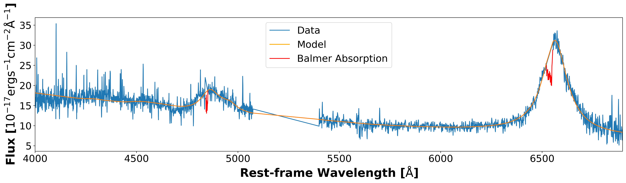
The IR Spectrum - Modelling Balmer Emission
H⍺
Hβ
Redshift (z) | Log(M_{SMBH} )[M⊙] | Log(L_{BOL} )[erg/s] | Log(L_{EDD}) [erg/s] | L_{BOL}/L_{EDD}
2.594 ±0.0002 | 10.05 ± 0.09 | 47.66 ± 0.18 | 48.15 ± 0.10 | 0.32 ± 0.15
Notes:
Here is the spectrum we obtained using the Apache Point Observatory. Using the spectral fitting software Sherpa, a Python package with which I am sure many of you are familiar, I was able to model the emission of both Halpa and H beta lines which we can clearly see here on the spectrum, as well as the OIII doublet which we believe to be present as well.
The spectral model which we see here in orange was constructed mainly from a power law component to model the continuum, a lorenztian component to model each of the peaks of the OIII doublet, a single gaussian component to model Hbeta, and a single Lorentzian component to model Halpha. Using the model position of the OIII doublet feature, we were able to calibrate the redishift of this quasar to 2.594 pm 0.0002. We were also able to directly extract the physical radius of the BLR of this outflow and the mass of the central SMBH for this quasar using the fit from H-alpha obtained from this spectrum. We estimate the radius of the BLR for SDSS J122933.32 to be approximately 855 lt-days from the central SMBH, which we estimate to have a mass of 1.13E10 Solar Masses pm 0.23E10 Solar Masses. We were also able to directly calculate the bolometric luminosity for this quasar- 4.5E47 erg/s pm 1.8 E47 erg/s. This is therefore a hyper-luminous quasar. Not only were we able to confirm Balmer absorption as predicted by the extension of the SimBAL models for the optical/UV spectra, but we were able to derive luminosities and other vital physical quantities for the quasar using well-calibrated lines which we did not have access to without APO. By calculating the mass of the central SMBH, we were, by extension, able to derive the Eddington luminosity (about 1.42E48 erg/s) for this quasar along with its corresponding Eddington ratio, about 0.3, in order to define this AGN’s accretion rate as sub-Eddington. I cannot emphasize enough how valuable a resource this APO spectrum has been to this project.

Slide 11
Future Work
Further quantitative outflow property calculations
Mass-loss rate
Kinetic Luminosity
Complete the large-scale dynamical model
Thank you for your attention!
Notes:
Future work on this project includes the derivation of further outflow properties such as the mass-loss rate and kinetic luminosity can be performed and ultimately used in order to complete the large-scale dynamical model for the cause of variability in this windy quasar. This brings me to the end of my presentation, thank you very much for all of your attention.☺

Slide 12

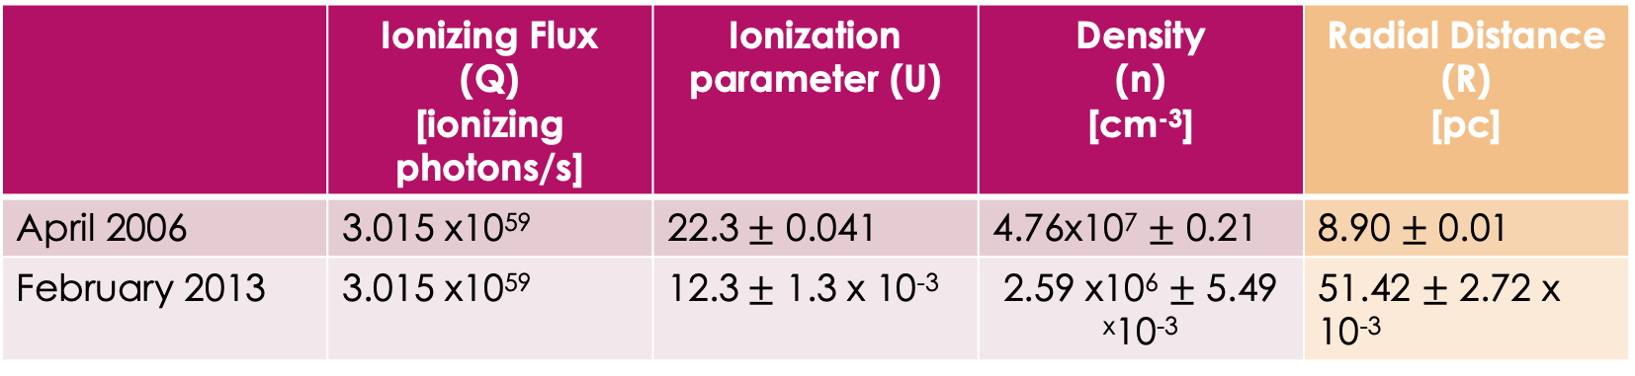
PRELIMINARY Radius Calculation $U=\frac{Q}{4πR^{2}nc}$
 | Ionizing Flux (Q) [ionizing photons/s] | Ionization parameter (U) | Density (n) [cm⁻³] | Radial Distance (R) [pc]
April 2006 | 3.015 x10⁵⁹ | 22.3$±$ 0.041 | 4.76x10⁷ $±$ 0.21 | 8.90 $±$ 0.01
February 2013 | 3.015 x10⁵⁹ | 12.3$±$ 1.3 x 10⁻³ | 2.59 x10⁶ $±$ 5.49 ^{x}10⁻³ | 51.42 $±$ 2.72 x 10⁻³
A change of about 43 parsecs in just under 2 years (1.86 years in quasar rest-frame)
Notes:
Using the extracted best-fitting parameter values, namely the ionization parameter and density, I was able to derive the radial distance of the probed outflow from the central SMBH in the quasar on both epochs. The general equation used to do this is given here in the top right hand corner of this slide. Using these known values and the values of the constants involved, I could rearrange this equation and solve for this physical location of the outflow at each instance in time. I have included the actual numerical values of each of the quantities involved in the calculations this little table here, and have calculated the outflow radius to be at a distance of about 6.5 parsecs on the first epoch, and then a distance of about 64 parsecs in the second epoch. The time between the two epochs in the rest-frame of the quasar is only approximately 1.86 years, and so this change of roughly 57 parsecs in this time is a huge! These two measurements are very important because they allow for a dynamical model to be constrained for this outflow.

Slide 13



Derived Outflow Properties
Outflow Radius
[pc]
Kinetic Luminosity
[erg/s]
Mass Outflow Rate
[M⊙/yr]
$$U=\frac{Q}{4πR^{2}nc}$$
$$Ė_{k}=\frac{Ṁυ^{2}}{2}$$
$$Ṁ=8πμm_{p}ΩRN_{H}υ$$
Notes:
Once the outflow radius has been derived, for example, further quantitative properties can be built on top of this information such as the mass outflow rate, which also uses information from the SimBAL models including the column densities and the outflow velocities. Ultimately, we would want to be able to use this mass outflow rate in order to calculate the corresponding kinetic luminosity. This is an important quantity to calculate, as it will act as a marker for the impact that the outflow will have on the host galaxy via feedback. This is the relationship we are most interested in in this investigation, after all.

Slide 14
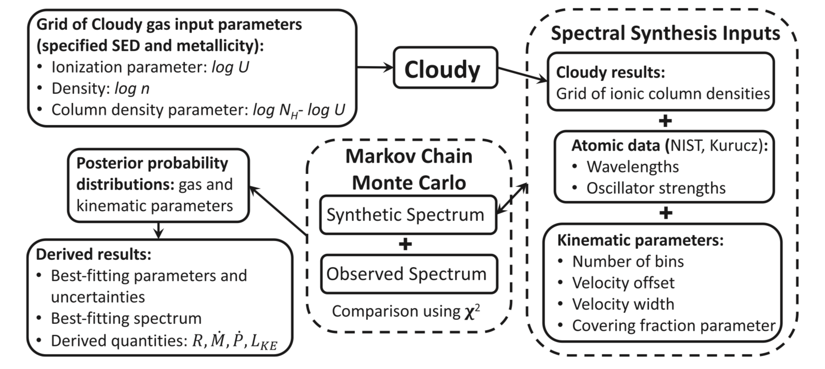
simBAL- Analyzing Broad Absorption Lines
Leighly et al. 2018. SimBAL analysis flow-chart.
Notes:
Just minutes ago, Joseph Choi has given us an excellent introduction to SimBAL, the spectral analysis software which was developed by him, Dr. Leighly, and the rest of their group at the University of Oklahoma. I have had the privilege to collaborate with them and use this new software in order to carry out my variability study. SimBAL must still be fresh in everyone’s minds at this point, and so I will not go into extraordinary detail on its inner-workings. Instead, I will just show this handy flow-chart to illustrate the general way in which we can derive results using SimBAL and briefly say that by supplying an initial best guess at a spectral model to SimBAL, the software is able to construct a synthetic or model spectrum which it tunes using a Markov Chain Monte Carlo algorithm. From the best-fitting spectral model, we are able to directly extract numerical values of best-fitting parameters for the spectrum we wish to fit. These parameters form the foundation for the large-scale physical models we wish to derive.

Slide 15
Variability in SDSS J122933.32
February 2013
April 2006
Notes:
As mentioned earlier, as the regions of interest for studying powerful quasar outflows cannot be spatially resolved using current technology, and as such, we rely on spectral variability studies as an important diagnostic tool for guiding our understanding of the origins of these powerful outflows. We observe spectroscopic variabililty in BALQs as in a change in strength of one or more spectral features as well as perhaps the appearance/disappearance of spectral features in time, though this is less likely to be observed.
Here I have included the two optical/UV spectra for FeLoBALQ J 122933.32 which I am studying, taken from the Sloan Digital Sky Survey. The first epoch was taken in April of 2006 and is given in red and the second epoch was taken nearly seven years later in February of 2013. We can see that this quasar is definitively exhibiting variability in several of its features as well as in the continuum emission. In general, observed changes such as these in spectral features are attributed to any combination of changes in the physical state of the gas as well as its position relative to the continuum emission source. By studying these changes, we are probing the physical state of the gas at distinct instances in time, and can begin to think about what kind of physical implications these changes imply in the context of the outflow we probe.

Slide 16
Ionization Parameter
-19.6% change!
Density
-16.5% change!
Column Density
0.228% change!
Covering Fraction
Index
-17.52% change!
Notes:
Using the best-fitting models for each epoch, I was able to directly extract the associated best-fitting values of each of the model parameters, some of which I have plotted here to illustrate how they change between the two epochs. I was primarily concerned with the ionization parameter, density, column density, and covering fraction. The values of the parameters from the first epoch are given in blue, and the values of the parameters for the second epoch are given in orange. Each parameter is given as a function of velocity, which is the x-axis in each of these plots. The 95% confidence intervals for each of these parameters are also given by the error bars on each of the points in this figure.
Starting with the ionization parameter in the top panel, we see that there is a pretty significant jump down from the ionization parameter in the first epoch to the that of the second epoch, and overall these values stay the same for the velocities we are looking at. Already we are seeing changes in the physical parameters which are consistent with the changes observed visually in each of the spectra!
Next, we see a similar change in the density of the outflow across epochs in the second panel from the top. The density of the outflow in the first epoch is much higher than that in the second, though both are roughly constant as functions of velocity. The intervening matter along our line of sight in the third panel, however, does not seem to be changing significantly in time or in velocity at all.
Finally, in the bottom panel we are taking a look at the extracted covering fraction index values, and can see that there might be a slight variation in the covering fraction as a function of velocity, but not so much as a function of time.

Slide 17
Summary of Findings
Successfully fit spectra for two epochs of observations of variable quasar SDSS J122933.32+262131.2 in the optical/UV regime and one in the IR.
Extracted best-fit parameters from SimBAL output; ionization parameter, density, column density, covering fraction index, velocity offset, etc.
Used extracted best-fit parameters to constrain the physical location of the outflow with respect to the central SMBH; a dynamical model.
Notes:
So this brings me now to a summary of my results from this project so far. In conclusion, I was able to use SimBAL, a novel spectral analysis software, in order to successfully fit two spectroscopic observations of variable quasar SDSS J122933.32. Using these fits, I was able to extract associated best-fitting parameters that yield information on the physical characteristics of the outflow which I am probing such as the ionization parameter, density, column density, etc. Further, I was able to use the extracted best-fit parameters for the models for each epoch in order to determine the radial location of the probed outflow in both cases with respect to the central SMBH.
SOFIA- get rid of! Too much and unnecessary?!

Slide 18
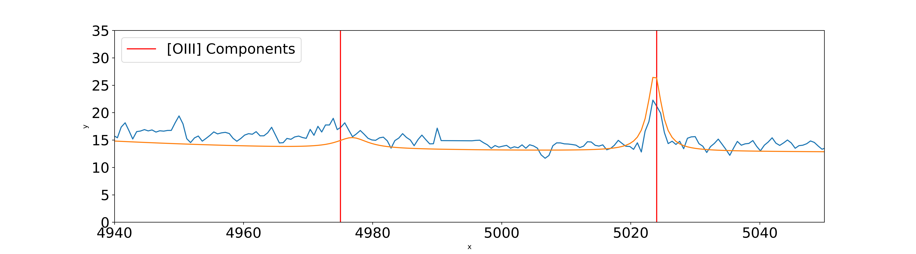

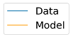

The IR Spectrum - Modelling Balmer Emission
H⍺
[OIII]
Hβ
Notes:
Here is the spectrum we obtained using the Apache Point Observatory. Using the spectral fitting software Sherpa, a Python package with which I am sure many of you are familiar, I was able to model the emission of both Halpa and H beta lines which we can clearly see here on the spectrum, as well as the OIII doublet which we believe to be present as well.
The spectral model which we see here in orange was constructed mainly from a power law component to model the continuum, a lorenztian component to model each of the peaks of the OIII doublet, a single gaussian component to model Hbeta, and a single Lorentzian component to model Halpha. Using the model position of the OIII doublet feature, we were able to calibrate the redishift of this quasar to 2.594 pm 0.0002. We also use the Halpha line in order to calibrate the redshift and in this case we get approximately 2.583. We were also able to directly extract the physical radius of the BLR of this outflow and the mass of the central SMBH for this quasar using the fit from H-alpha obtained from this spectrum. We estimate the radius of the BLR for SDSS J122933.32 to be approximately 855 lt-days from the central SMBH, which we estimate to have a mass of 1.13E10 Solar Masses pm 0.23E10 Solar Masses. We were also able to directly calculate the bolometric luminosity for this quasar- 4.5E47 erg/s pm 1.8 E47 erg/s. This is therefore a hyper-luminous quasar. Not only were we able to confirm Balmer absorption as predicted by the extension of the SimBAL models for the optical/UV spectra, but we were able to derive luminosities and other vital physical quantities for the quasar using well-calibrated lines which we did not have access to without APO. By calculating the mass of the central SMBH, we were, by extension, able to derive the Eddington luminosity (about 1.42E48 erg/s) for this quasar along with its corresponding Eddington ratio, about 0.3, in order to define this AGN’s accretion rate as sub-Eddington. I cannot emphasize enough how valuable a resource this APO spectrum has been to this project.

Slide 19
The IR Spectrum - Modelling Balmer Emission
H⍺
[OIII]
Hβ
Redshift (z) | Log(M_{SMBH} )[M⊙] | Log(L_{BOL} )[erg/s] | Log(L_{EDD}) [erg/s] | L_{BOL}/L_{EDD}
2.594 ±0.0002 | 10.05 ± 0.09 | 47.66 ± 0.18 | 48.15 ± 0.10 | 0.32 ± 0.15
Notes:
Here is the spectrum we obtained using the Apache Point Observatory. Using the spectral fitting software Sherpa, a Python package with which I am sure many of you are familiar, I was able to model the emission of both Halpa and H beta lines which we can clearly see here on the spectrum, as well as the OIII doublet which we believe to be present as well.
The spectral model which we see here in orange was constructed mainly from a power law component to model the continuum, a lorenztian component to model each of the peaks of the OIII doublet, a single gaussian component to model Hbeta, and a single Lorentzian component to model Halpha. Using the model position of the OIII doublet feature, we were able to calibrate the redishift of this quasar to 2.594 pm 0.0002. We were also able to directly extract the physical radius of the BLR of this outflow and the mass of the central SMBH for this quasar using the fit from H-alpha obtained from this spectrum. We estimate the radius of the BLR for SDSS J122933.32 to be approximately 855 lt-days from the central SMBH, which we estimate to have a mass of 1.13E10 Solar Masses pm 0.23E10 Solar Masses. We were also able to directly calculate the bolometric luminosity for this quasar- 4.5E47 erg/s pm 1.8 E47 erg/s. This is therefore a hyper-luminous quasar. Not only were we able to confirm Balmer absorption as predicted by the extension of the SimBAL models for the optical/UV spectra, but we were able to derive luminosities and other vital physical quantities for the quasar using well-calibrated lines which we did not have access to without APO. By calculating the mass of the central SMBH, we were, by extension, able to derive the Eddington luminosity (about 1.42E48 erg/s) for this quasar along with its corresponding Eddington ratio, about 0.3, in order to define this AGN’s accretion rate as sub-Eddington. I cannot emphasize enough how valuable a resource this APO spectrum has been to this project.

